Slide 1
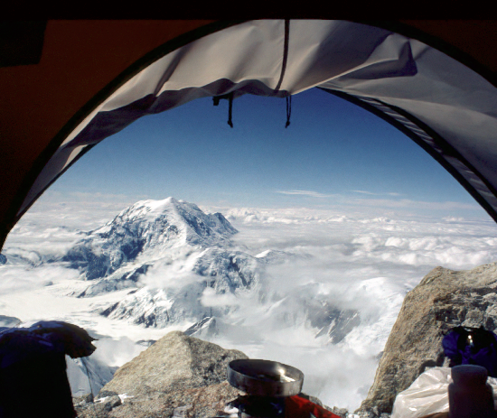
Chapter 6, System Design: Decomposing the System

Slide 2
System Design: Decomposing the System
“There are two ways of constructing a software design: One way is to make it so simple that there are obviously no deficiencies, and the other way is to make it so complicated that there are no obvious deficiencies.”
— C.A.R. Hoare, in The Emperor’s Old Clothes

Slide 3
System Design: Decomposing the System
System design is the transformation of an analysis model into a system design model.
During system design, developers:
define the design goals of the project and decompose the system into smaller subsystems that can be realized by individual teams;
select strategies for building the system, such as: the hardware/software strategy, the persistent data management strategy, the global control flow, the access control policy, and the handling of boundary conditions.
The result of system design is a model that includes a subsystem decomposition and a clear description of each of these strategies.

Slide 4
System Design: Decomposing the System
S D is not algorithmic. Developers have to make trade-offs among many design goals that often conflict with each other. They also cannot anticipate all design issues that they will face because they do not yet have a clear picture of the solution domain.
System design is decomposed into several activities:
• Identify design goals. Developers identify and prioritize the qualities of the system that they should optimize.
• Design the initial subsystem decomposition. Developers decompose the system into smaller parts based on the use case and analysis models. Developers use standard architectural styles as a starting point during this activity.
• Refine the subsystem decomposition to address the design goals.

Slide 5
Figure 6-1, Example of iterative floor plan design. Three successive versions show how we minimize walking distance and take advantage of sunlight.
Version 2
Version 1
Stairs
Stairs
Study
Bedroom2
Study
Dining
Kitchen
Kitchen
Hallway
Entrance door
Hallway
Entrance door
Dining
Bath
Master
Bedroom2
Bath
Master
Bedroom
Bedroom
N
Stairs
Entrance
door
Study
Bath
Bedroom2
Kitchen
Hallway
Dining
Master
Bedroom
Version 3

Slide 6
Figure 6-2, The activities of system design.
nonfunctional
requirements
Analysis
dynamic model
analysis object
model
System design
design goals
subsystem
decomposition
Object design
object design
model

Slide 7
System Design: System Design concepts
Subsystems provide services to other subsystems.
A service is a set of related operations that share a common purpose. During system design, we define the subsystems in terms of the services they provide. Later, during object design, we define the subsystem interface in terms of the operations it provides.
Properties of subsystems:
Coupling measures the dependencies between two subsystems, whereas cohesion measures the dependencies among classes within a subsystem. Ideal subsystem decomposition should minimize coupling and maximize cohesion.

Slide 8
System Design: System Design concepts
Two techniques for relating subsystems to each other :
Layering allows a system to be organized as a hierarchy of subsystems, each providing higher-level services to the subsystem above it by using lower-level services from the subsystems below it.
Partitioning organizes subsystems as peers that mutually provide different services to each other.

Slide 9
Figure 6-3, Subsystem decomposition.
System
Part
*
*
Class
Subsystem
parts

Slide 10
Figure 6-4, Subsystem decomposition for an accident management system.
FieldOfficerInterface
DispatcherInterface
Notification
IncidentManagement
ResourceManagement

Slide 11
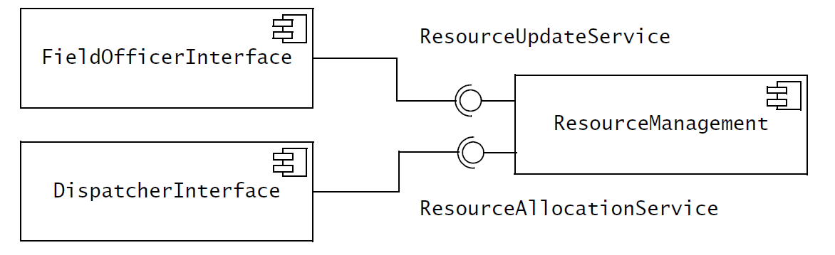
Services provided by the ResourceManagement subsystem

Slide 12
Figure 6-5, Example of reducing the couple of subsystems.
Alternative 1: Direct access to the Database subsystem
ResourceManagement
IncidentManagement
MapManagement
Database

Slide 13
Figure 6-5, Example of reducing the couple of subsystems (continued)
Alternative 2: Indirect access to the Database through a Storage subsystem
ResourceManagement
IncidentManagement
MapManagement
Storage
Database

Slide 14
Figure 6-6, Decision tracking system.
DecisionSubsystem
assesses
Criterion
Alternative
*
*
*
DesignProblem
solvableBy
based-on
resolvedBy
SubTask
*
Decision
ActionItem
implementedBy
Task
subtasks

Slide 15
Figure 6-7, Alternative subsystem decomposition for the decision tracking system of Figure 6-6
RationaleSubsystem
Criterion
assesses
Alternative
*
*
*
DesignProblem
solvableBy
based-on
resolvedBy
Decision
PlanningSubsystem
implementedBy
SubTask
*
ActionItem
Task
subtasks

Slide 16
Figure 6-8, Subsystem decomposition of a system into three layers.
A: Subsystem
Layer 1 (Top)
B:Subsystem
C:Subsystem
D:Subsystem
Layer 2
E:Subsystem
F:Subsystem
G:Subsystem
Layer 3 (Bottom)
In a closed architecture, each layer can access only the layer immediately below it.
In an open architecture, a layer can also access layers at deeper levels.

Slide 17
Figure 6-9, An example of closed architecture: the OSI model.
Application
Presentation
Format
Session
Connection
Level of abstraction
Transport
Message
Network
Packet
DataLink
Frame
Physical
Bit

Slide 18
Figure 6-10, An example of closed architecture.
Application
Presentation
Object
CORBA
Session
Transport
Socket
Network
TCP/IP
DataLink
Physical
Ethernet
Wire

Slide 19
Figure 6-11, An example of open architecture: the Swing user interface library on the X11 platform.
Application
Swing
AWT
Xlib

Slide 20
Figure 6-12, Repository architectural style.
As the complexity of systems increases, the specification of system decomposition is critical. It is difficult to modify or correct weak decomposition once development has started, as most subsystem interfaces would have to change.
Repository
Subsystem
createData()
setData()
getData()
searchData()
In recognition of the importance of this problem, the concept of software architecture has emerged. A software architecture includes: system decomposition, global control flow, handling of boundary conditions, and intersubsystem communication protocols [Shaw & Garlan, 1996].

Slide 21
Figure 6-12, Repository architectural style.
Repositories are well suited for applications with constantly changing, complex data processing tasks.
Once a central repository is well defined, we can easily add new services in the form of additional subsystems.
The main disadvantage of repository systems is that the central repository can quickly become a bottleneck, both from a performance aspect and a modifiability aspect.
The coupling between each subsystem and the repository is high, thus making it difficult to change the repository without having an impact on all subsystems.

Slide 22
Figure 6-13, An instance of the Repository architectural style.
Compiler
SemanticAnalyzer
SyntacticAnalyzer
Optimizer
LexicalAnalyzer
CodeGenerator
Repository
ParseTree
SymbolTable
SourceLevelDebugger
SyntacticEditor

Slide 23
Figure 6-14, Model/View/Controller architectural style.
model subsystems maintain domain knowledge,
view subsystems display it to the user,
controller subsystems manage the interactions with the user.
Controller
initiator
*
1
repository
Model
1
notifier
View
subscriber
*
Model subsystems do not depend on any view or controller subsystem. Changes in their state are propagated to the view subsystem via a subscribe/notify protocol. The MVC is a special case of the repository where Model implements the central data structure

Slide 24
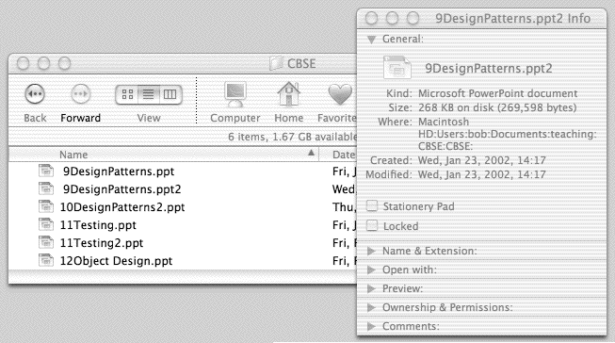
Figure 6-15, An example of MVC architectural style.

Slide 25
Figure 6-16, Sequence of events in the Model/View/Control architectural style.
2:enterNewFileName(file,newName)
3:setName(newName)
:Controller
1:subscribeToFileEvents(file)
:Model
5:getName()
:InfoView
4:notifySubscribedViews(file)
4:notifySubscribedViews(file)
:FolderView
1:subscribeToFileEvents(file)
5:getName()

Slide 26
Figure 6-17, Client/server architectural style.
Server
Client
*
*
requester
provider
service1()
service2()
…
serviceN()

Slide 27
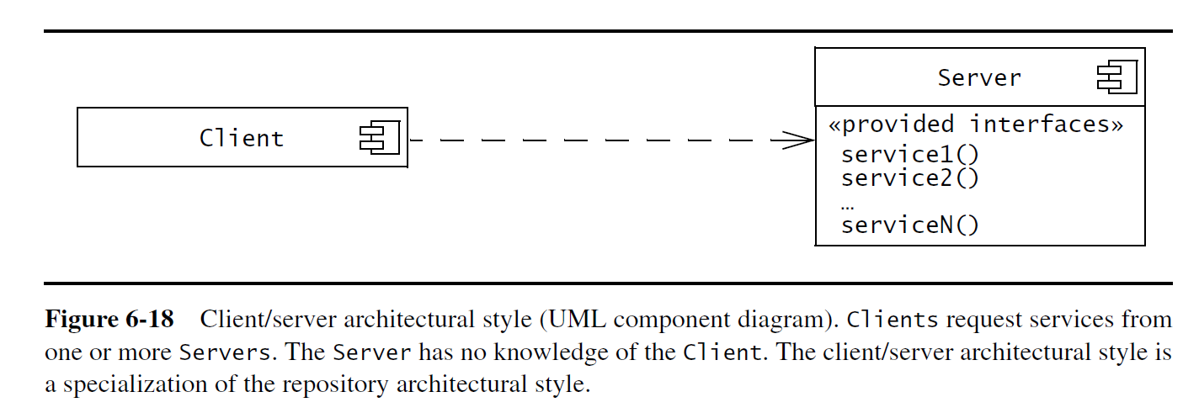
Figure 6-17, Client/server architectural style.

Slide 28
Figure 6-18, The World Wide Web as an instance of the client/server architecture.
netscape:WebBrowser
www12.in.tum.de:WebServer
iexplorer:WebBrowser
lynx:WebBrowser
www.cs.cmu.edu:WebServer
mosaic:WebBrowser

Slide 29
Figure 6-19, Peer-to-peer architectural style.
A peer-to-peer architectural style is a generalization of the client/server architectural style in which subsystems can act both as client or as servers.
Peer
requester
*
service1()
service2()
*
…
serviceN()
provider
Each subsystem can request and provide services. The control flow within each subsystem is independent from the others except for synchronizations on requests.

Slide 30
Figure 6-20, An example of peer-to-peer architecture.
application1:DBUser
1. updateData
database:DBMS
application2:DBUser
2. changeNotification
Peer-to-peer systems are more difficult to design than client/server systems because they introduce the possibility of deadlocks and complicate the control flow.

Slide 31
Figure 6-21, Three-tier architectural style.
The storage layer, an analog to the Repository subsystem in the repository architectural style, can be shared by several different applications operating on the same data
Interface
Form
Application Logic
Connection
Storage
Query
The separation between the interface layer and the application logic layer enables the development or modification of different user interfaces for the same application logic.

Slide 32
Figure 6-22, Four tier architectural style.
Presentation Client
WebBrowser
Presentation Server
Form
Application Logic
Connection
Storage
Query

Slide 33
Figure 6-23, Pipe and filter architectural style.
A Pipe connects one of the outputs of a Filter to one of the inputs of another Filter.
*
input
output
1
Filter
Pipe
*
output
input
1
Each filter is executed concurrently, and synchronization is accomplished via the pipes. The pipe and filter architectural style is modifiable: filters can be substituted for others or reconfigured to achieve a different purpose.

Slide 34
Figure 6-24, An instance of the pipe and filter architectural style.
the Unix shell [Ritchie &Thompson, 1974].
% ps auxwww | grep dutoit | sort | more
dutoit 19737 0.2 1.6 1908 1500 pts/6 O 15:24:36 0:00 -tcsh
dutoit 19858 0.2 0.7 816 580 pts/6 S 15:38:46 0:00 grep dutoit
dutoit 19859 0.2 0.6 812 540 pts/6 O 15:38:47 0:00 sort
ps
grep
sort
more
Pipe and filter styles are suited for systems that apply transformations to streams of data without intervention by users. They are not suited for systems that require more complex interactions between components, such as an information management system or an interactive
system.

Slide 35
Figure 6-27, Analysis model for the MyTrip route planning and execution.
RouteAssistant
PlanningService
Trip
Location
Direction
Destination
Crossing
Segment

Slide 36
Figure 6-28, Initial subsystem decomposition for MyTrip.
RoutingSubsystem
PlanningSubsystem
RouteAssistant
PlanningService
Trip
Location
Direction
Destination
Crossing
Segment

Slide 37
Figure 6-29, An example of the Facade pattern.
Compiler
Compiler
compile(s)
CodeGenerator
Lexer
create()
getToken()
Optimizer
Parser
create()
generateParseTree()
ParseNode
create()

